Slide 1

Market Analysis Report
Online Shopping’s Been Easy Since 2023
This project is also posted on GitHub.

Slide 2
Business Problem: Shop Easy, the online retailer is losing clients.
Marketing noticed a drop in conversions from viewing their webpage to making a purchase.
They suffered a noticeable loss in their social media presence.
There was a large number of negative reviews on products.
Identified KPIs:
Conversion rate – client visitors over those who made a purchase.
Social Media – those who interacted in posts, videos, etc.
Customer Reviews – clients who purchased a product and left a comment based on their personal interaction.

Slide 3
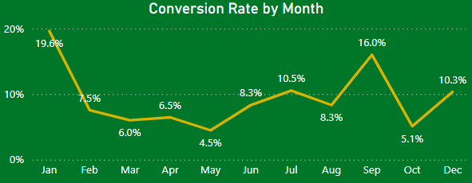
KPI - Conversion rate
by Month
Monthly conversion rates varied throughout the year.
January saw the highest rate of 19.6% that dipped to a lowest rate of 4.5% in May.
Rates rose again in September to 16%, dipped to 5.1% in October and then trended back up to 10.3% again in December.

Slide 4
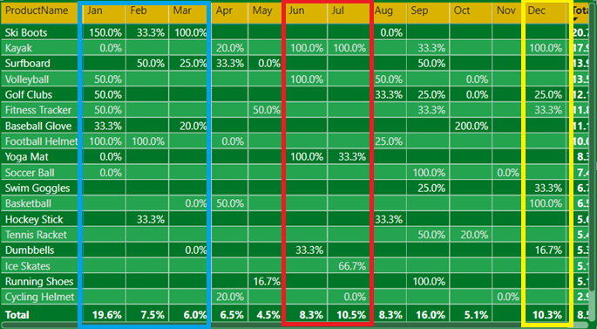
KPI - Conversion rate
by Product
Our top item converted was ski boots at 150% in January
Next over varied months were kayaks, football helmets, and yoga mats.
Early Winter and Mid Summer were our most successful months involving conversion rates.

Slide 5
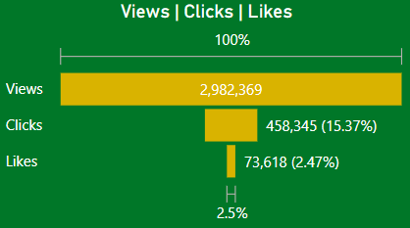
KPI – Social Media
Overview
Overall social media presence was high at almost 3 million views in total.
The number of post viewers who clicked to visit our website were moderate at 15%.
Actual interactions with posts were low at 2.5% of viewers.

Slide 6
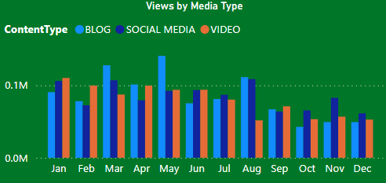
KPI – Social Media
Views by Media Type
March and May had our highest views by blog post.
Our social media posts as a whole declined in views at the end of the year.
On average video posts were viewed the least.

Slide 7
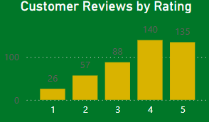
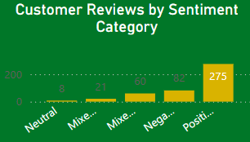
KPI – Customer Reviews
Reviews by Rating
Overall customer ratings were positive with the majority being at a 4 or 5.
Sentiment analysis showed a strong mix of how clients felt about products but remained overall positive.

Slide 8
Identified Goals for Next Quarter:
Increase website conversion from page views to product purchase
Enhance client social media presence so that they engage more with our social media marketing staff online and their posts.
Improve customer feedback to keep product referrals and site revisits high.

Slide 9
Recommended Actions for Next Quarter:
Conversion Rates
Conversion rates were on the rise in December and likely trend into January based on our data from this year.
Look for those high converting items in the first quarter such as ski boots and general fitness items.
Target marketing campaigns at seasonal items for appropriate seasons:
Fitness trends at the beginning of each year
Spring sports such as baseball, soccer, and running
Summer activities and sport camps for football and back to school
Winter activities and the Holiday Season toward the end of the year

Slide 10
Recommended Actions for Next Quarter:
Social Media
Social media had a strong decline throughout the year.
Social media and blog posts had success but with some revitalization and experimenting with video posts, our marketing staff could boost views and client engagement.
Some ideas to boost video post interactions:
Tiktok and Instagram Reels are popular platforms
See what is trending and integrate that into our ad campaigns
Post content that primes viewers to comment and be ready to respond to comments – interactions lead to conversions!

Slide 11
Recommended Actions for Next Quarter:
Customer Reviews
Overall our customer reviews remained mostly positive at an average of 3.67 almost meeting our company goal of a 4 rating.
Some ideas to address negative comments:
Take a look at who left negative and mixed reviews and investigate why they left them
Develop a plan for follow-up and address their concerns for the opportunity for a rerate
Look into QA to see where the breakdown in product quality might be
Rebrand items that see a noticeable change and offer a discount

Slide 12
The following slides present the Power BI Dashboards used to answer our business questions and allowed us to make recommendations.

Slide 13
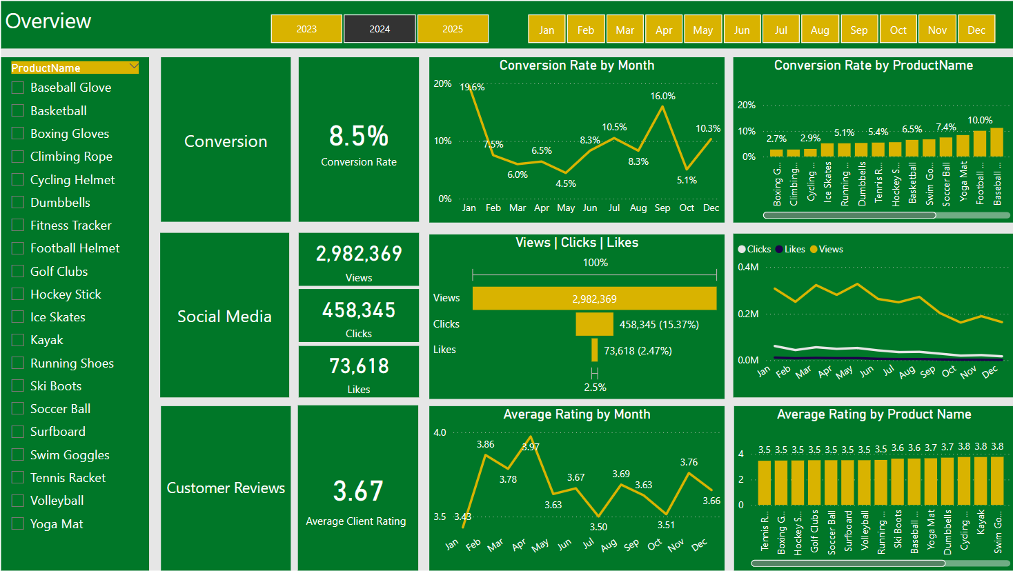

Slide 14
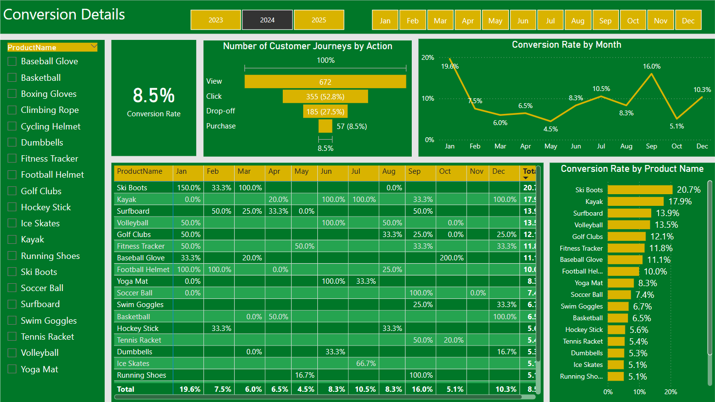

Slide 15
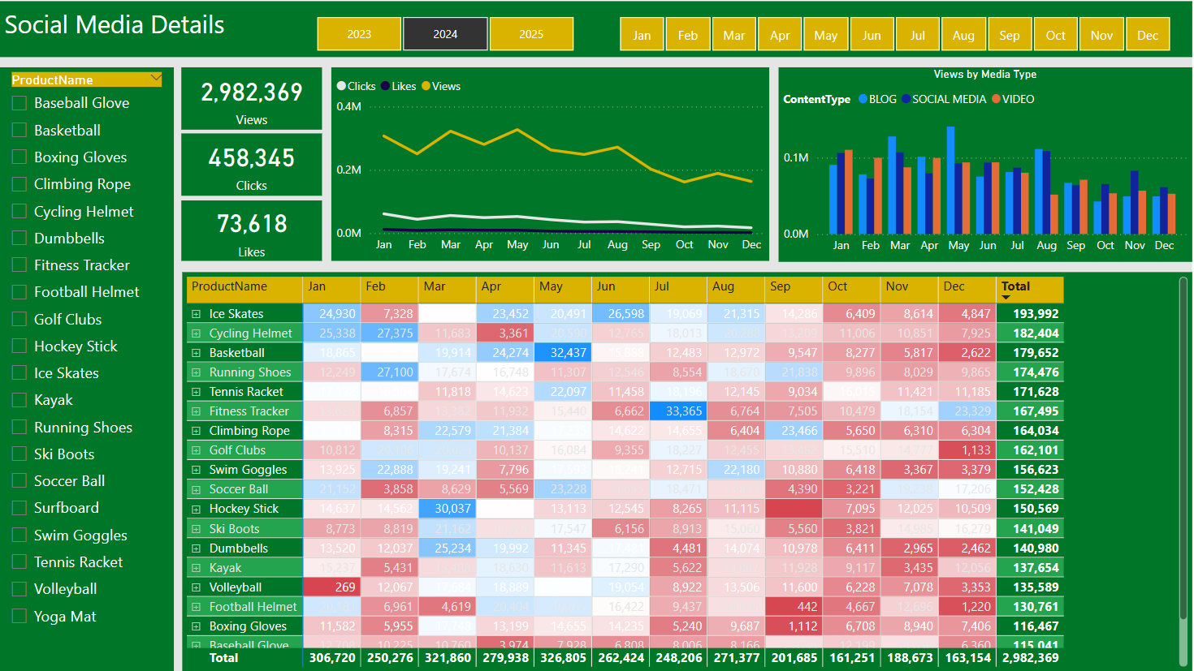

Slide 16
